Slide 1
UCSD Embedded Linux Assignment 3
By
Hsuankai Chang
hsuankac@umich.edu

Slide 2
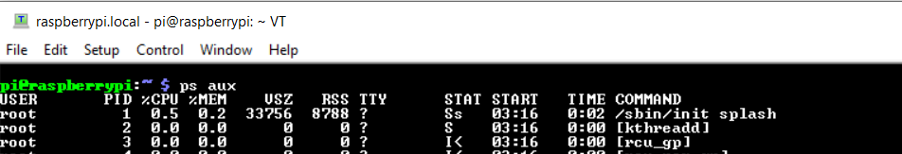
Step 1. /sbin/init

Slide 3
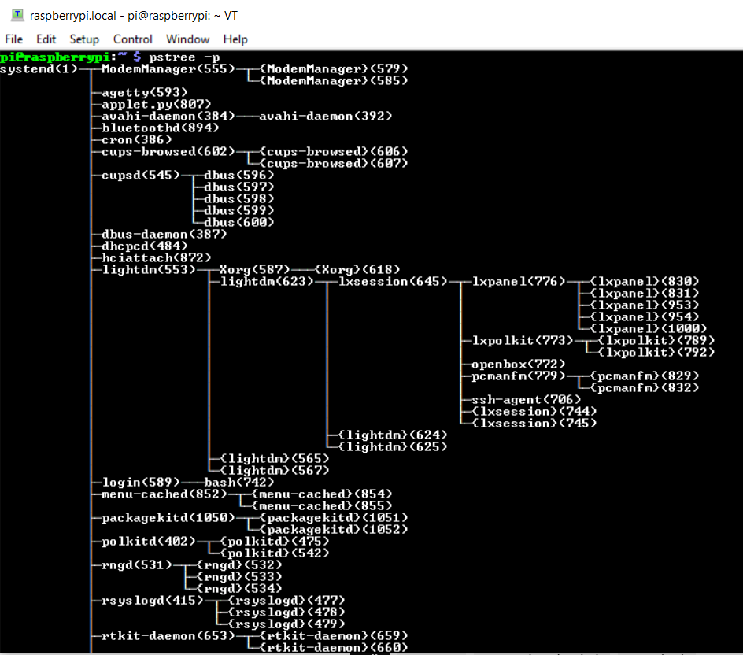
Step 2. pstree -p

Slide 4
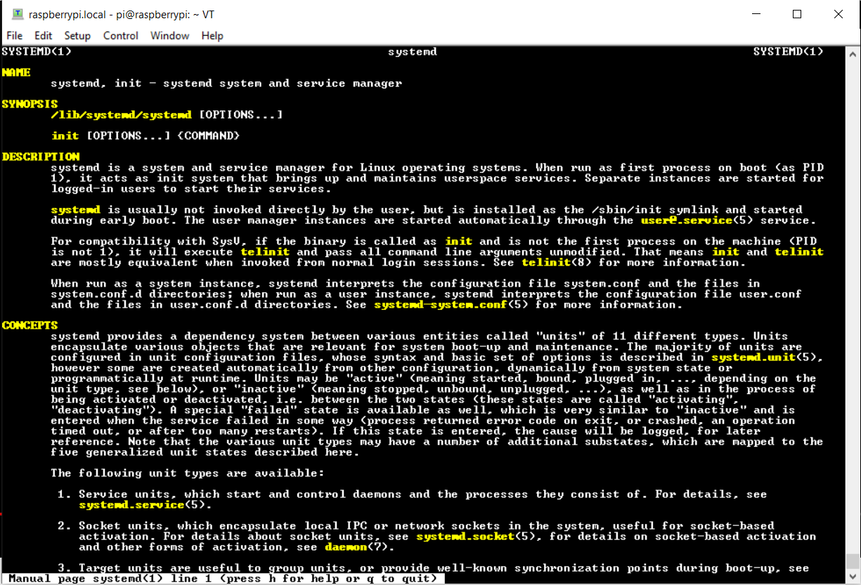
Step 3. man systemd

Slide 5
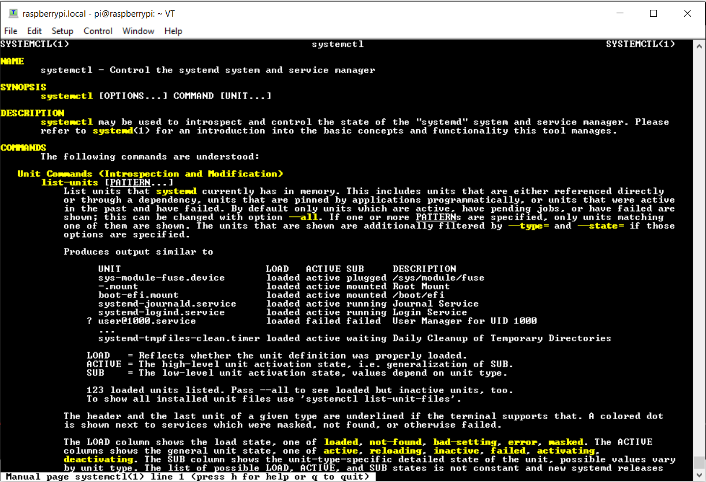
Step 4. man systemctl

Slide 6
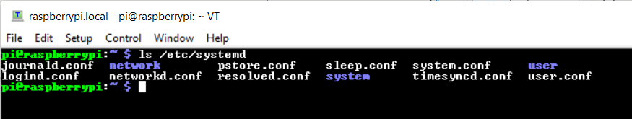
Step 5. /etc/systemd

Slide 7
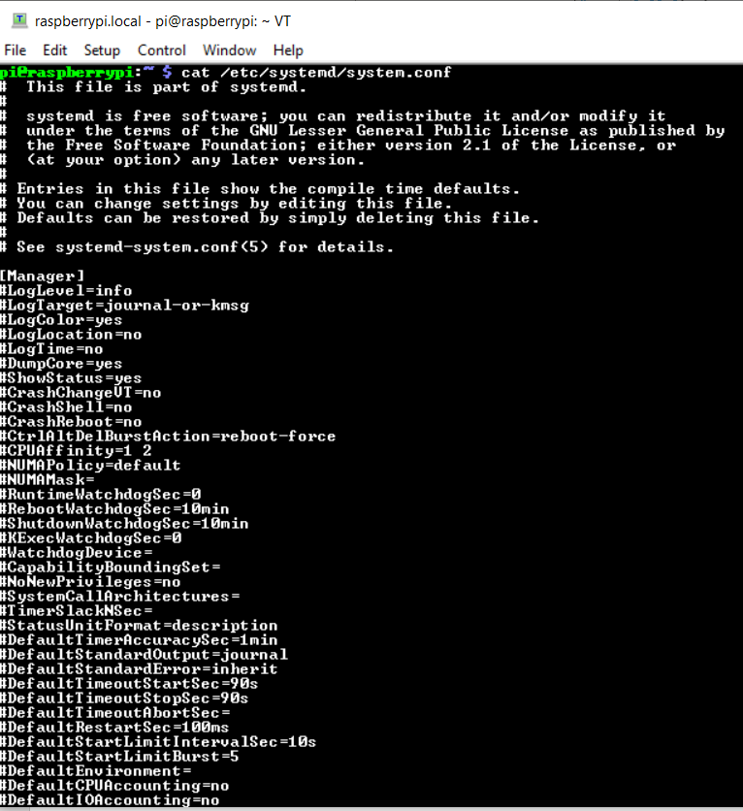
Step 6. /etc/systemd/system.conf

Slide 8
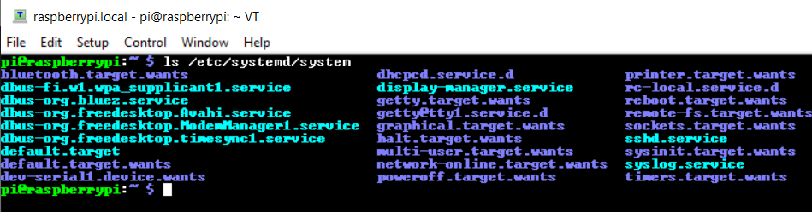
Step 7. /etc/systemd/system

Slide 9
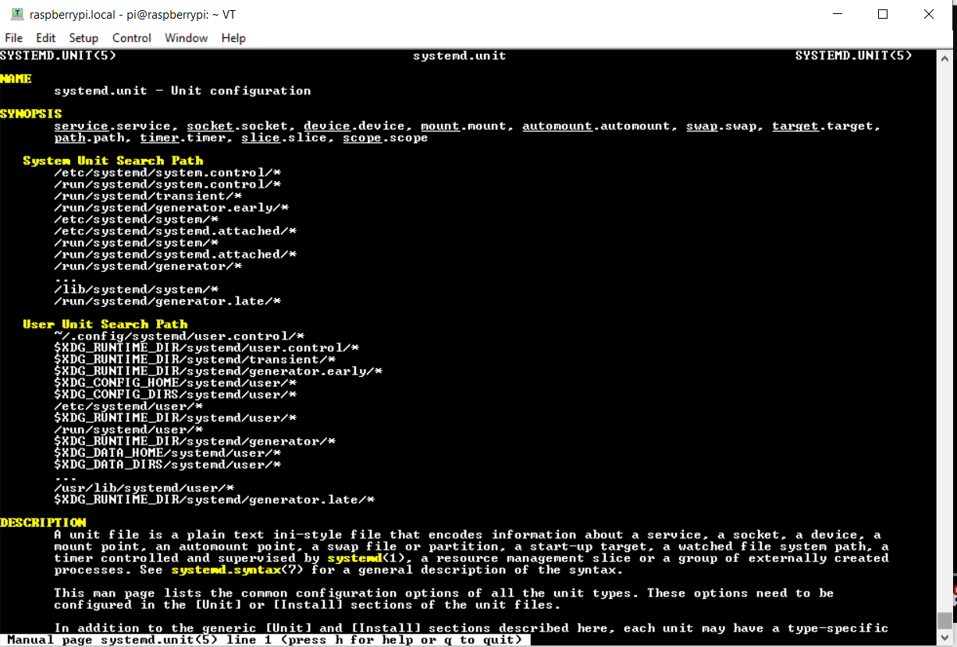
Step 8. man systemd.unit.

Slide 10
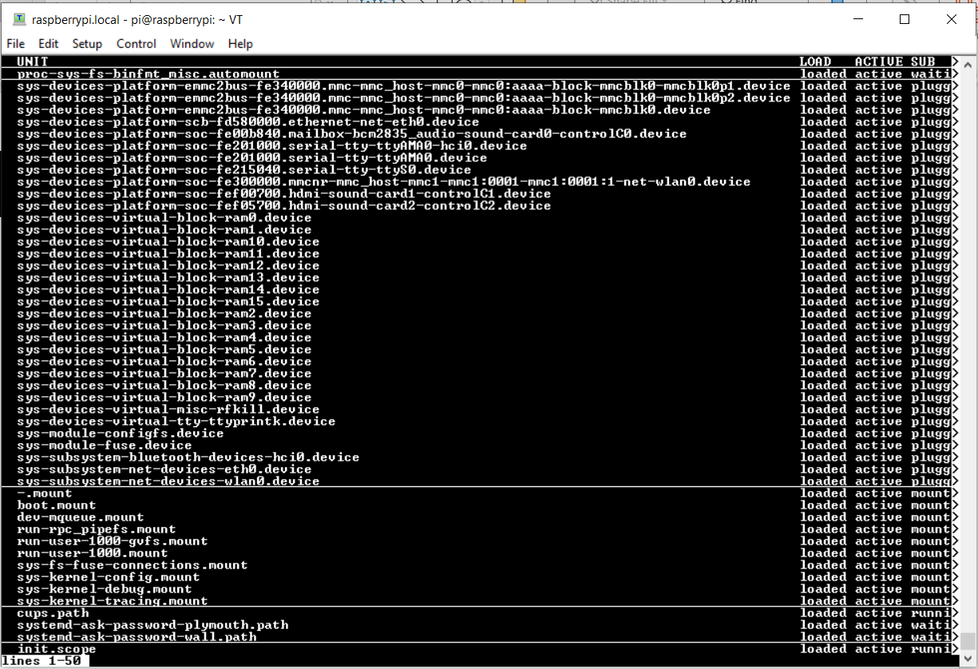
Step 9. systemctl

Slide 11
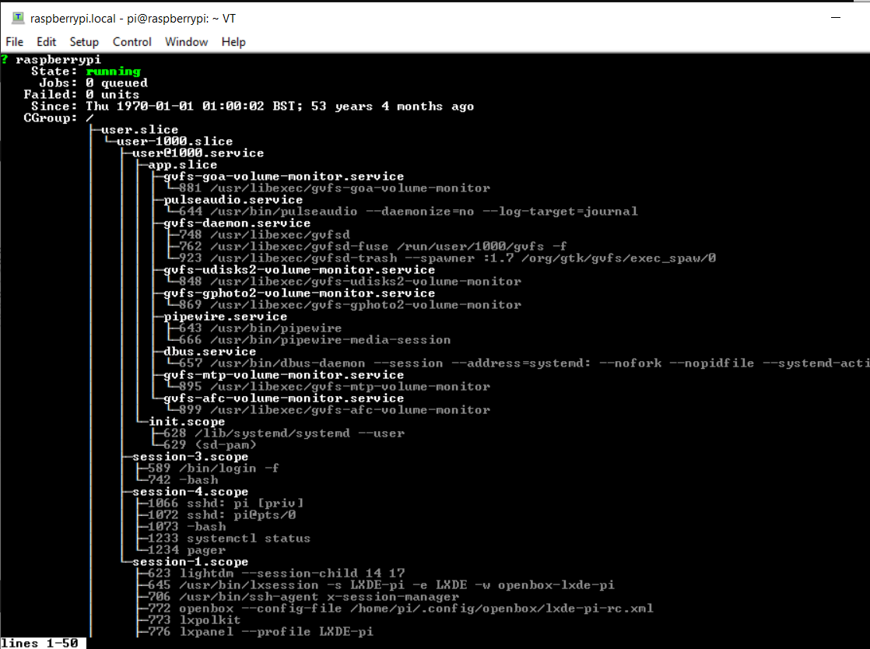
Step 10. systemctl status

Slide 12
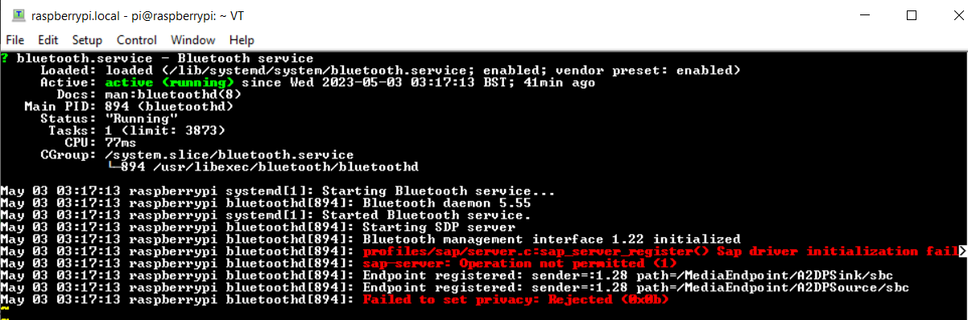
Step 11. systemctl status bluetooth

Slide 13
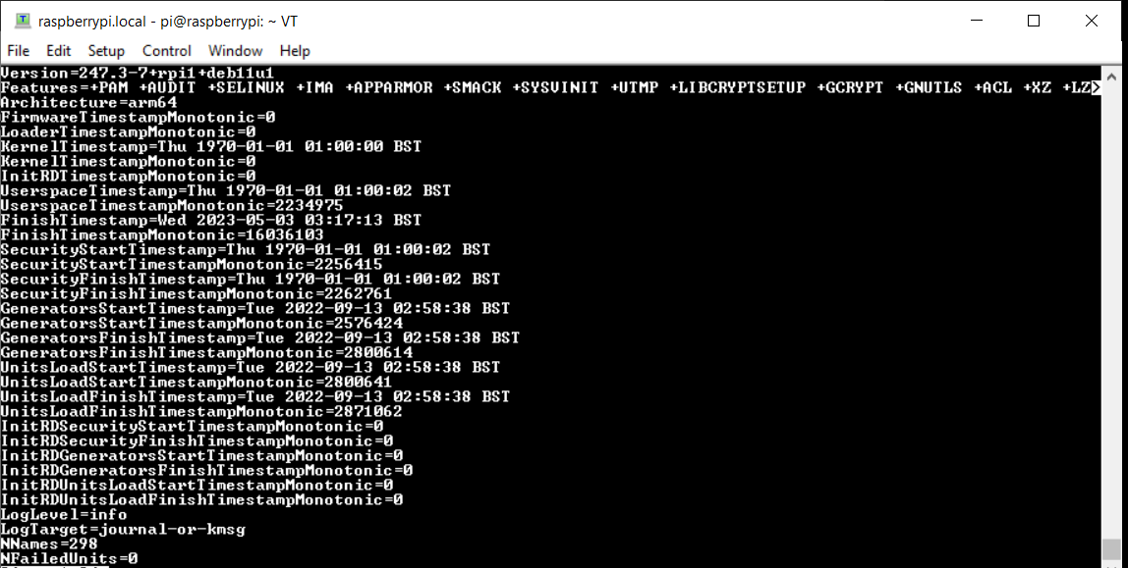
Step 12. systemctl show

Slide 14
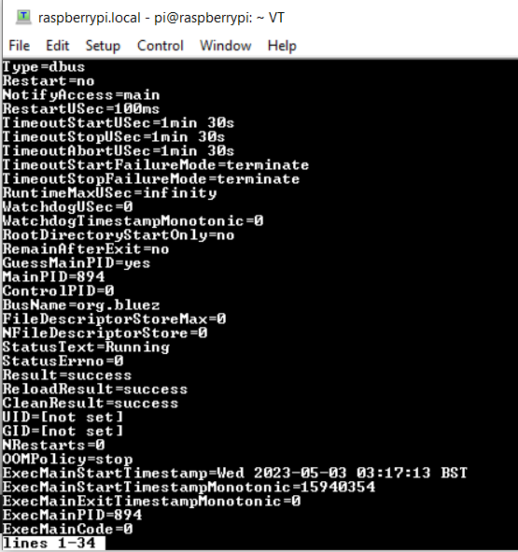
Step 13. systemctl show bluetooth

Slide 15
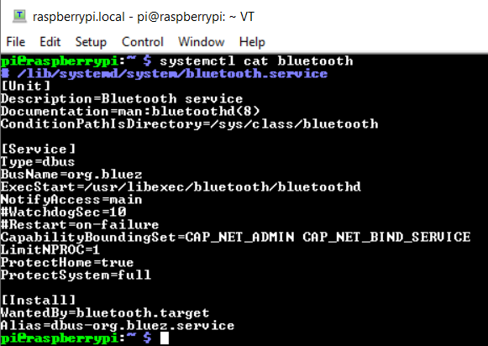
Step 14. systemctl cat bluetooth

Slide 16
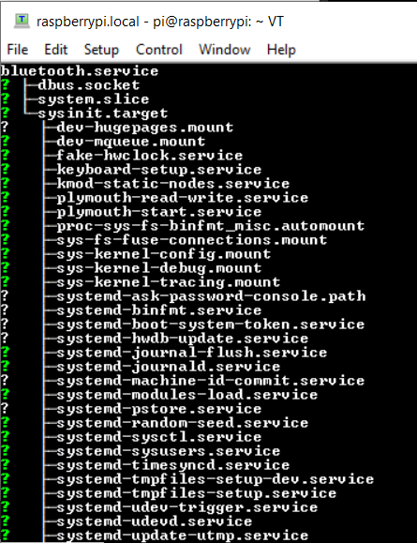
Step 15. systemctl list-dependencies bluetooth

Slide 17
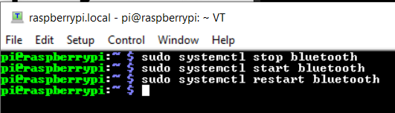
Step 16. sudo systemctl start/stop/restart bluetooth

Slide 18
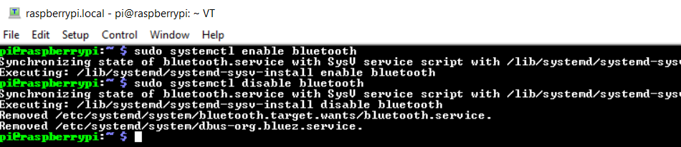
Step 17. systemctl enable/disable bluetooth

Slide 19
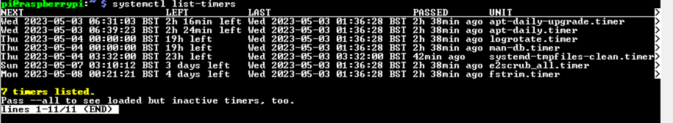
Step 18. systemctl list-timers

Slide 20
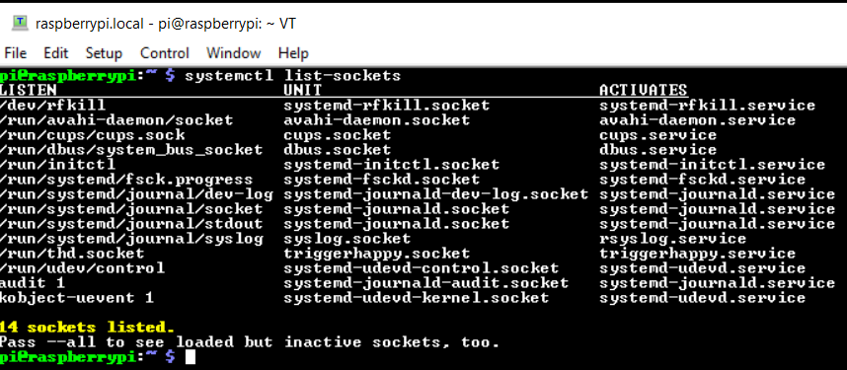
Step 19. systemctl list-sockets

Slide 21
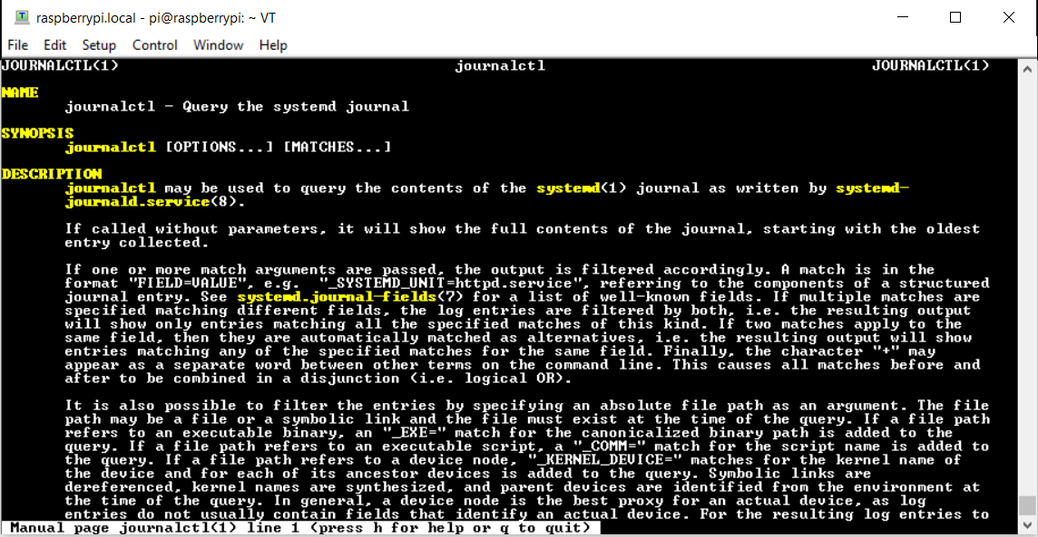
Step 20. man journalctl

Slide 22
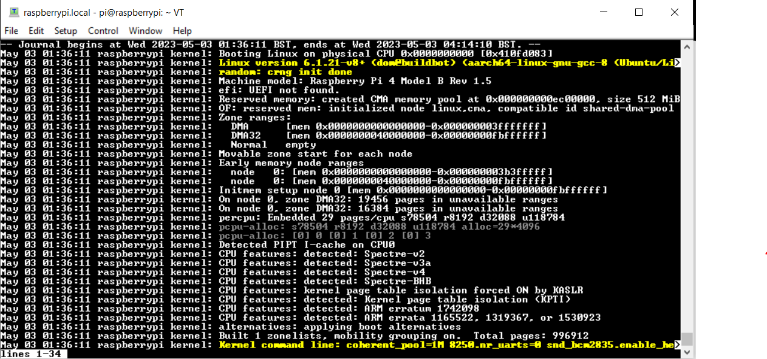
Step 21. journalctl

Slide 23
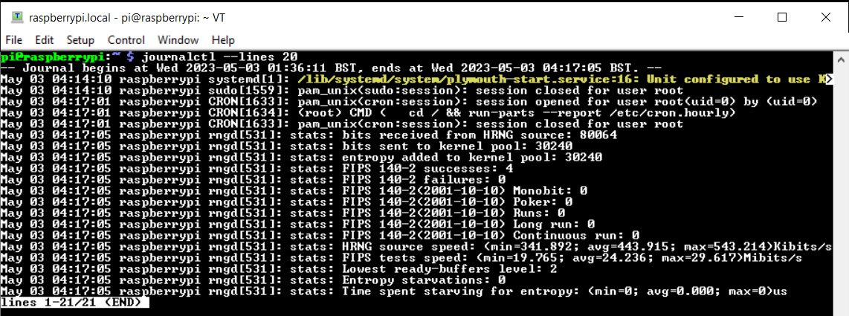
Step 22. journalctl --lines 20

Slide 24
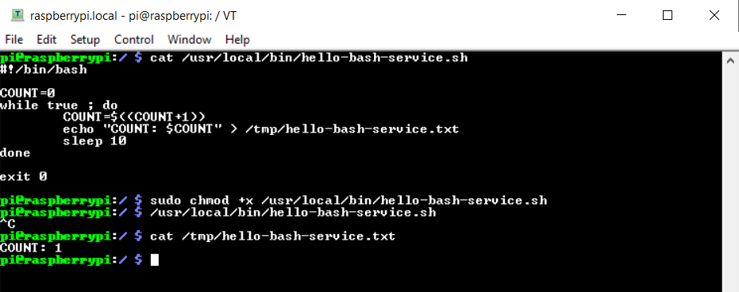
Step 23. Creating a “Hello World” Service - Part 1

Slide 25
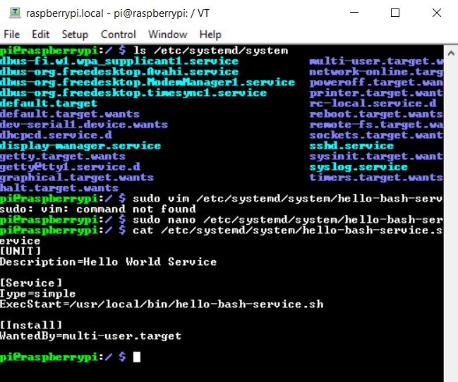
Step 24. Creating a “Hello World” Service - Part 2

Slide 26
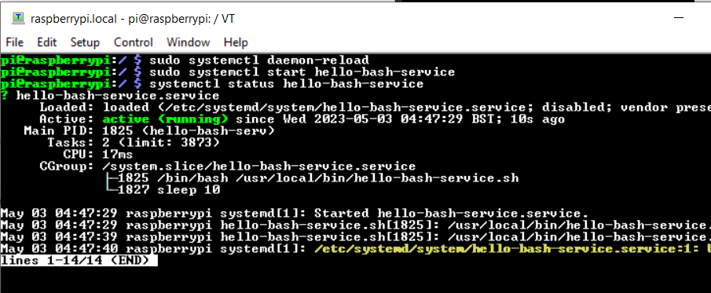
Step 25. Creating a “Hello World” Service - Part 3

Slide 27
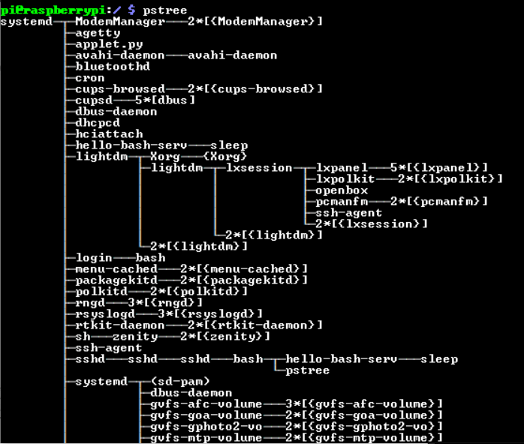
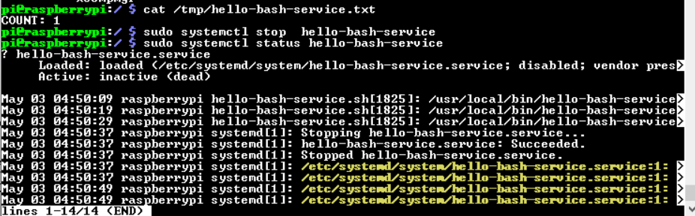
Step 26. Creating a “Hello World” Service - Part 4

